Slide 1






Agenda
This presentation will cover the purpose of the code, functionality overview, logic behind skill matching, user interaction, code execution steps, displaying results, limitations, practical applications, integration with larger projects, and open Q&A.

Slide 2
Purpose of the Code
The main objective of the code is to identify resumes containing specific skills. It aims to streamline the process of identifying suitable candidates based on their skill sets.

Slide 3
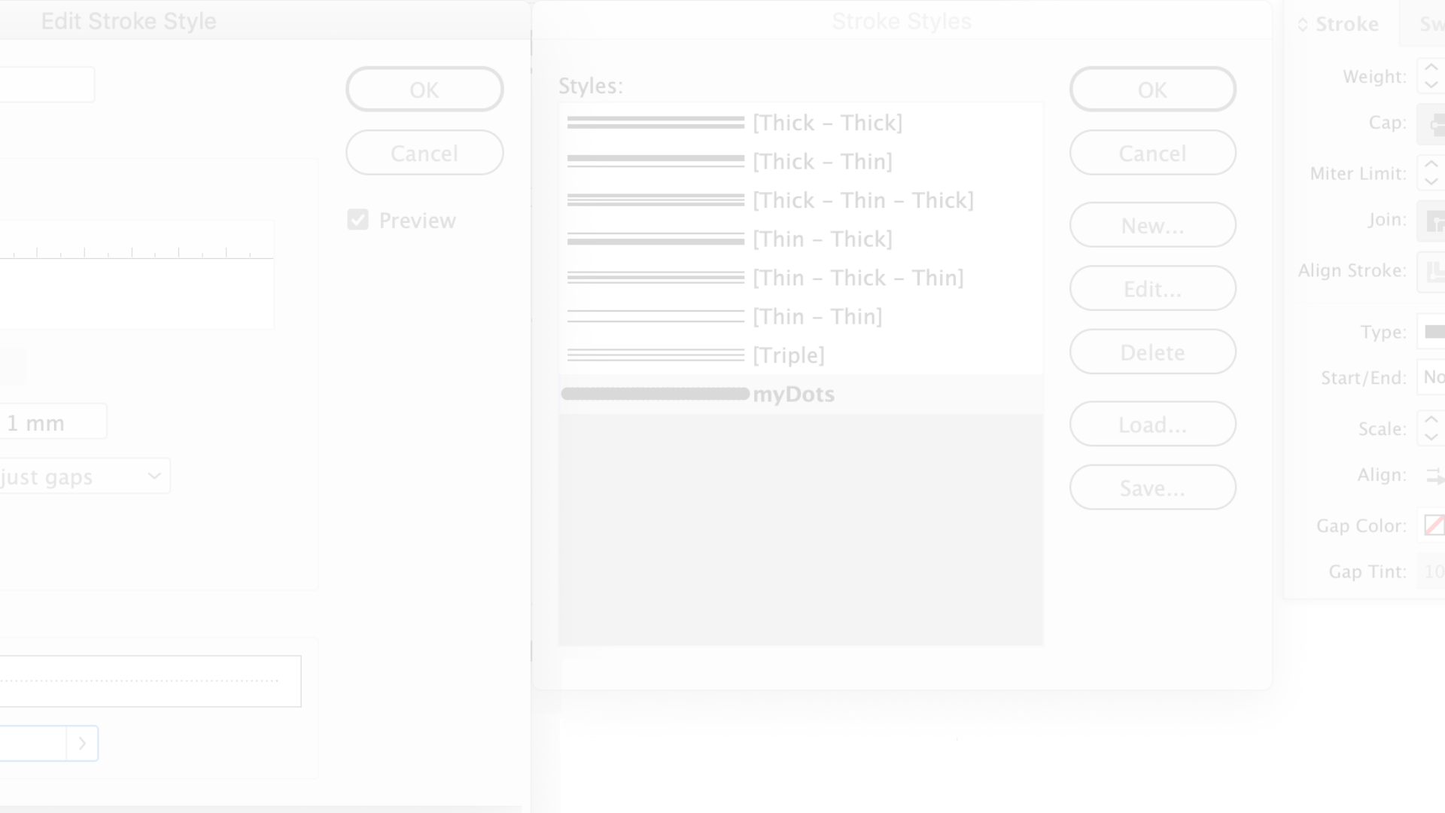
Functionality Overview
The code utilizes PyPDF2 for PDF processing, enabling the extraction of text from resumes in PDF format. Additionally, it leverages NLTK's word_tokenize for efficient text tokenization, aiding in the identification of relevant skills.

Slide 4
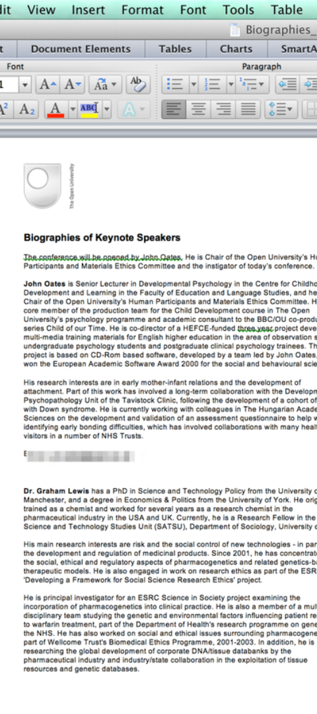
Logic Behind Skill Matching
The Python script extracts text from resumes in PDF format, further tokenizing it to facilitate skill matching. It emphasizes case-insensitive matching to ensure comprehensive skill identification.

Slide 5
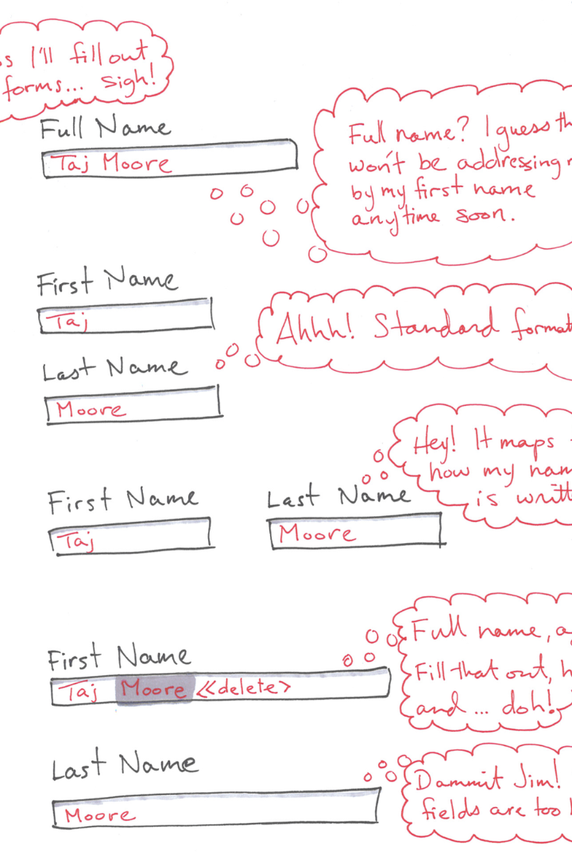
User Interaction
The user interface prompts the input of skills, emphasizing the necessity of comma-separated input to effectively process and match the specified skills.

Slide 6
Displaying Results
Upon execution, the code displays the results, showcasing the paths of resumes that match the specified skills. This allows for a quick and efficient assessment of potential candidates.

Slide 7
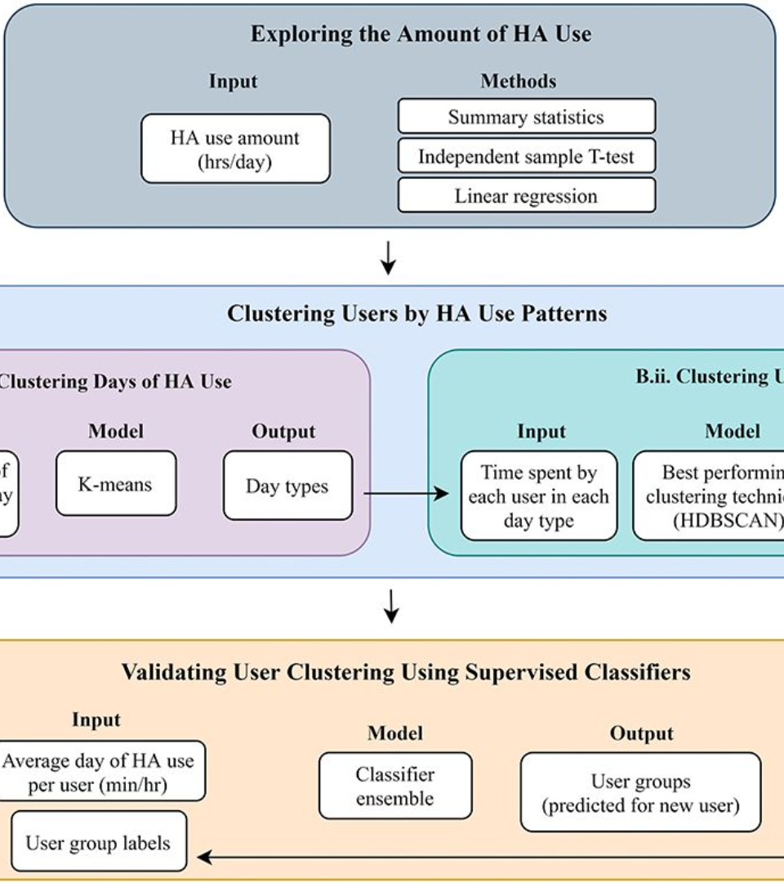
Practical Applications
This section delves into various real-world scenarios where the code can prove beneficial, particularly emphasizing its relevance in data analysis and talent acquisition processes.

Slide 8

Feuji Vizag:
Rakesh .Chappa
Data Analytics
Associate Software Engineer
9182151890
.

